Slide 1

Travel Guide Software

Slide 2
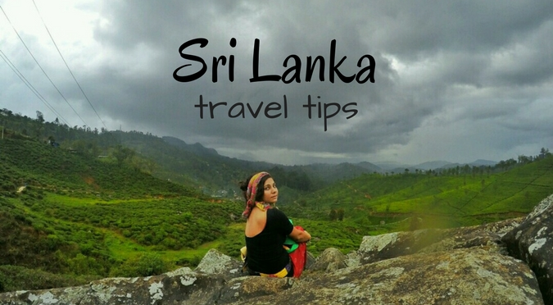
The easiest and best way to travel in Sri Lanka

Slide 3

Everything you need before and during your trip to Sri Lanka in one place .

Slide 4
Now you don't need tour guides, travel advisors .
Now you have no difficulty in planning the trip .
Now you don't have to think about the traffic during the trip .
Now you will not have a problem with food and accommodation during the trip.
Now you can travel easily with less capital .
Now you have a friend by your side to help you get everything you need during your trip before your trip.

Slide 5
To get a small understanding of the software, let's consider an example of one part of it. When you go to the upper right corner of this software, a bar appears down.
Go map
Gest house map
Transport map
Restaurants map
Chat lanka
massages
Emergency centre
Log out
When we travel as usual, we should take support from the above and provide the necessary facilities and go to the "Go map" to go to the map that shows how we travel according to our travel map and location while we travel.
You can also solve your problems through "chat lanka" and get any necessary information in your own language.
The "massages" icon will give you all the bills you need along with the gest house, restaurant, transport method and the massages related to the chat .
Through the Emergency centre, it is possible to call the government agencies for assistance in any case of emergency, and it also provides the convenience of contacting an agent and the convenience of getting solutions through chat.

Slide 6
We have only talked about the privileges that the visitor gets here, but in addition, we are an intermediary party, and there is a big profile that one cannot see when using the software for organizations that provide services that are essential for our work, individuals, vehicle owners, taxi owners and many other groups of people. Meanwhile, we are included in the software after a lot of research and we have a group of employees to monitor whether the services will be provided so that the people who are included will not be a fraud for the tourists and the inconvenience will be minimized .In fact, we have another small software for managing service providers, registration and maintenance process.

Slide 7
Advantages
The convenience of a traveller planning and checking all the details before arriving for the trip without any fear or doubt.
Ease of getting everything reliably at a low cost to the customer .
The possibility of not getting caught by fraudsters and making a better trip with less money.
Due to increased reliability and convenience and many other advantages, the country has many economic benefits due to the increase in the number of tourists coming to Sri Lanka.
Without language being a problem, many people can easily make money by meeting tourists and making money for the country through quality service instead of needlessly exploiting tourists.

Slide 8
Disadvantages
Loss of some job opportunities .
Signal issues causing travel issues in some areas
Download and use today.

Slide 9
THANK YOU
NAME : H.P.S.Ekanayaka
NIC NO. : 200029502012
REGISTRATION NO : 520919
COURSE TITLE : Higher National Diploma in Computing
UNIT NUMBER : 47
UNIT TITLE : Emerging Technologies

